Slide 1
Health and Wealth of Nations

Slide 2
Indicators of Health
Infant mortality rate
HIV/AIDS rate in adults

Slide 3
Indicators of Wealth
GDP per capita

Slide 4
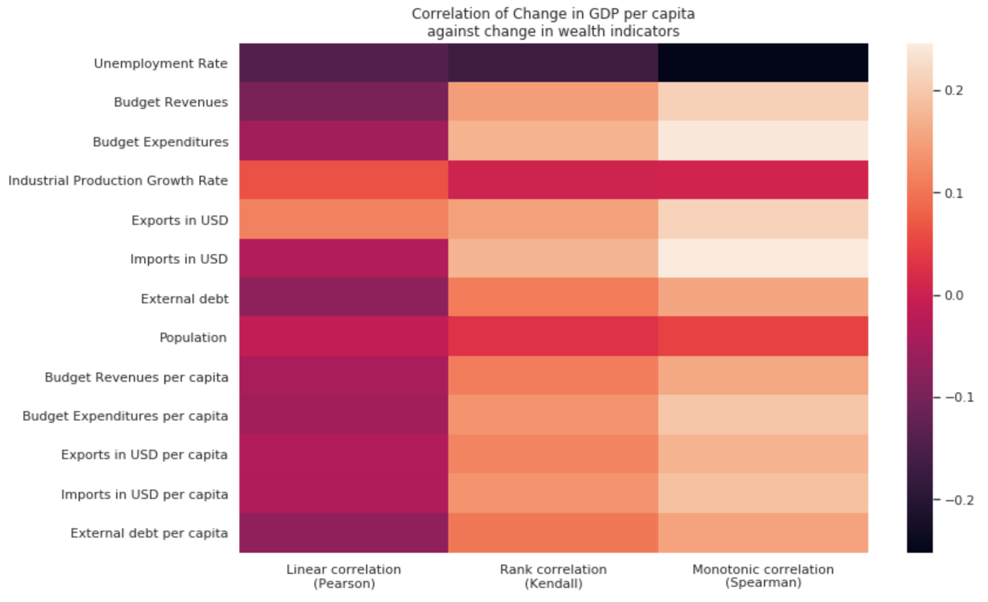

Slide 5
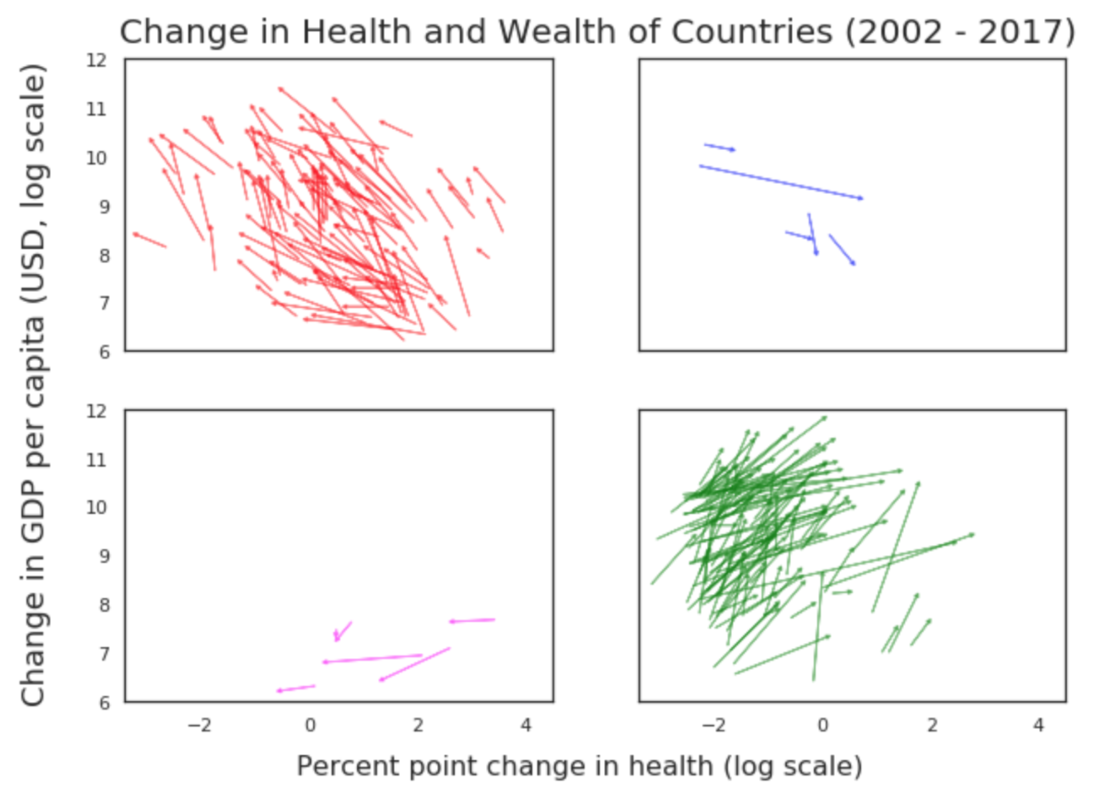

Slide 6
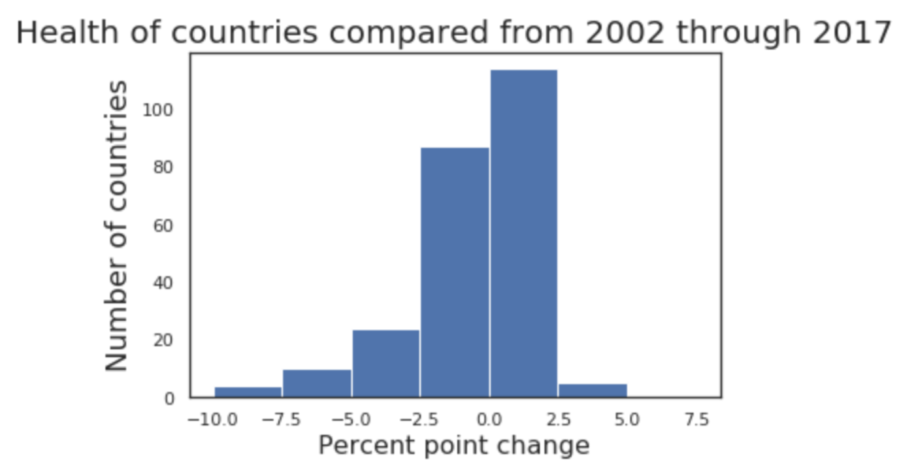

Slide 7
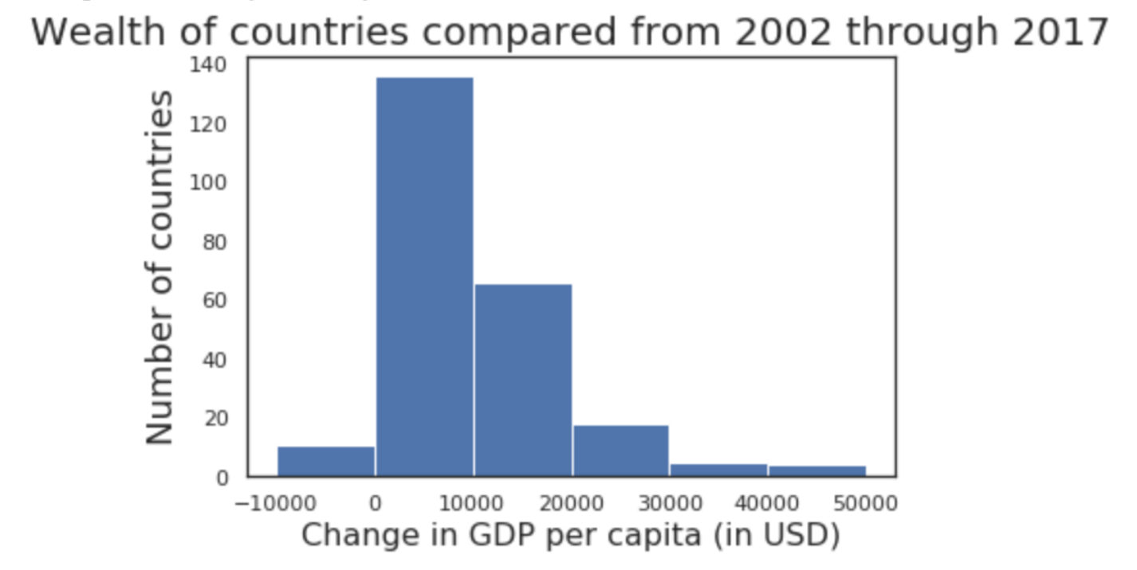

Slide 8
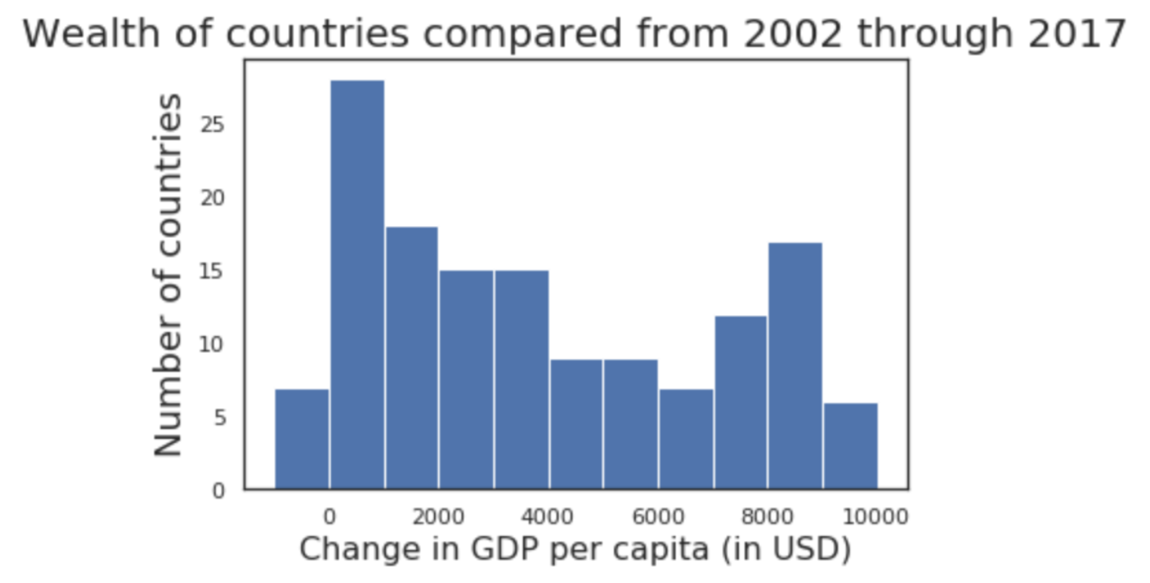

Slide 9
